Slide 1

Accepable SAT/ACT for Stereotype Asian Parents
Supadit W.
MINK

Slide 2
ศุภดิฐ วโนทยาพิทักษ์ [Mink]
Education: MBBS, Bachelor of Medicine and Bachelor of Surgery
(Capital Medical University, Beijing, China)
首都医科大学
Career: Full-time trader
Tiktoker
Data Scientist (not quite yet)
Personality: Being Mink

Slide 3
Agenda
If I was stereotype Asian-American Parent, What data might interest me?
1) Acceptable Score
2) Acceptable Major for my kids
3) Acceptable School
4) Cost of Living
5) Suitable state
Conclusion

Slide 4


Instagram vs. Real-life

Slide 5
Before digging data up
In the class of 2020, SAT test-takers: 2.2 million > ACT test-takers: 1.7 million
More and more students are taking both (last 5 to 10 years )
SAT costs 52 USD and ACT costs 55 USD (70 USD if the optional writing test is included)
Students may also be able to take the SAT or ACT for free thanks to state support or fee waivers.

Slide 6

Don’t think! Go test!
Although SAT and ACT is not required in most schools in the USA at the time (1,000++), many schools made it optional for students to send SAT/ACT score along with your GPA and Activities report.(Leadership program, Volunteer, etc.)
What if there are other students who got the same GPA and the same Activities report at current situation where SDT still exist?
SDT: standardized test

Slide 7

As a reminder

Slide 8
SAT OR ACT OR BOTH
SAT 2019,2018,2017 | ACT 2019,2018,2017
Mean = 1106.53 - 1126.1 is equivalent to 21-22 in ACT. | Mean ≈ 21 is equivalent to 1060~1090 in SAT.
SAT mean ≈ ACT mean
Min = 935-977 is equivalent to 17-18 in ACT | Min ≈ 18 is equivalent to 960-980 in SAT.
SAT min ≈ ACT min exception : 2017 min value = 2.3 (Someone didn't read enough textbooks)
SAT max = 1284 - 1295 is equivalent to 27 in ACT. | ACT max ≈ 25 is equivalent to 1200-1220 in SAT.
SAT max > ACT max
SAT:400-1600
ACT: 1-36

Slide 9
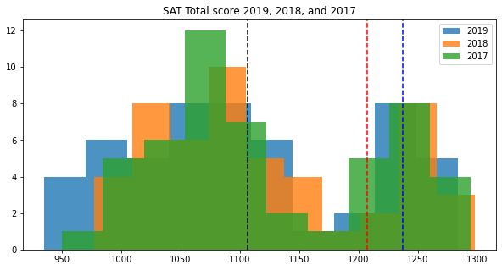
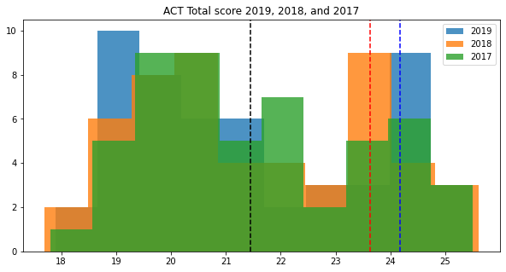
SAT and ACT score distribution shows we have two groups of population
Black line ; Mean
Red line: Mean+SD
Blue line: Mean+1.3SD
Black line ; Mean
Red line: Mean+SD
Blue line: Mean+1.25SD

Slide 10
Similar Distribution
(2 peaks)
Similar Mean

Slide 11
Acceptable score for Asian-Parents
Average STDDev : 94.61
Average Mean : 1119.73
Average Max : 1292.33
Calculation | Score | Asian Parent’s Satisfaction | Real-life
Mean + 3SD | 1403.56 | Good | 8% from 1.5M (SAT 2021)
Mean + 2SD | 1308.95 | Acceptable | Reachable
Mean + SD | 1214.34 | Study harder | Great score
Mean + 1/2SD | 1167.04 | Disgrace to ancestors | Good Score
Mean | 1119.73 | I’m not your father | Mean Score

Slide 12
Acceptable major for Asian-Parents
College Major | Accept Rate
Clinical Sciences | 18%
Business, Management, Marketing | 12%
Engineering | 11%
Biological/Biomedical Sciences | 8%
and not Arts | 7%

Slide 13
Acceptable school for Asian-Parents
School | Accept Rate
Stanford University – California | 4.3%
Harvard College – Massachusetts | 4.7%
Princeton University – New Jersey | 5.5%
Columbia University – New York | 5.5%
Yale University - Connecticut | 6.1%
California Institute of Technology | 6.4%
MIT - Massachusetts | 6.7%

Slide 14
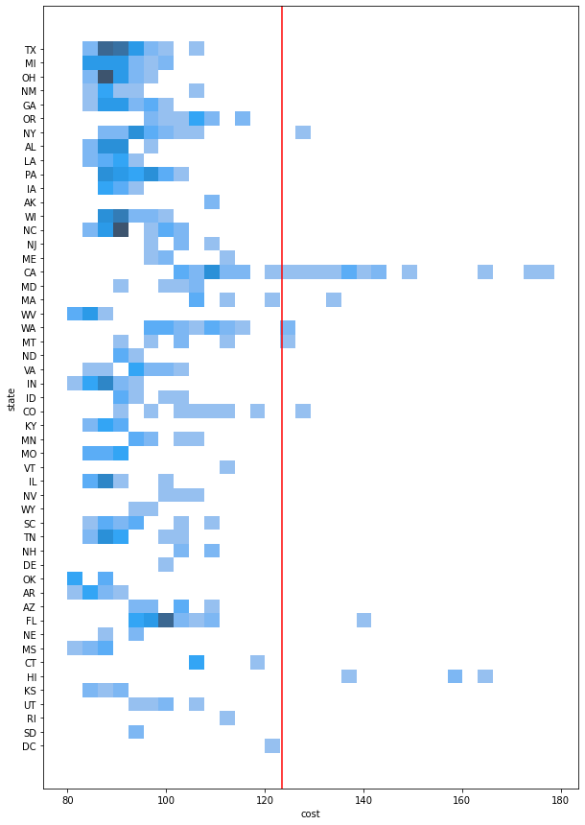
Cost of living index in USA (Normal=100)
Cost of living index | Value | Note to self
Mean | 97 | Ok!
Mean + SD | 109.98 | Aight!
Mean + 2SD | 123.43 | This is getting hard
Mean + 3SD | 136.87 | I ‘m struggling
Max | 178.6 | I’m dead
The cost of living of some cities in eight states goes beyond 2SD which are
New York , California, Massachusetts, Washington
Montana, Colorado, Florida, Hawaii.

Slide 15
Cost of living index (Normal=100)
State | School | Mean cost of living index
California | Standford University California Institure of Techonology | 125.75
Massachusetts | Harvard College MIT | 114.55
Connecticut | Yale University | 108.56
New Jersey | Princeton University | 103.4
New York | Columbia University | 97.04

Slide 16
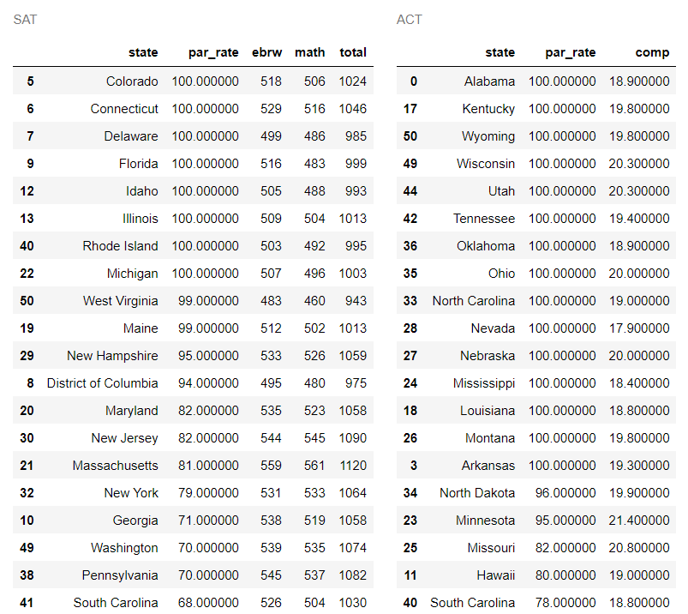
Be one step ahead
Higher Total score
Mean value
State with total ≥20 | Cost of living index ≤ 100
Wisconsin | ≤ 100
Ohio | < 100
Nebraska | < 100
Missouri | < 100
Lower
Cost of living Index
State Support
Or
Fee waivers

Slide 17
Conclusion
SAT are for simpletons
Asian’s Mean value = Mean+1.3SD(SAT), Mean+1.25SD(ACT)
Major: Clinical Sciences, Business, Engineering, Biological/Biomedical Sciences
Acceptable school (not in California): Harvard College, MIT, Yale University,
Princeton University, and Columbia University
Asian parents will move to Wincoston, Ohio, Nebraska, Missouri

Slide 18
Conclusion
SAT are for simpletons
Asian’s Mean value = Mean+1.3SD(SAT), Mean+1.25SD(ACT)
Major: Clinical Sciences, Business, Engineering, Biological/Biomedical Sciences
Acceptable school (not in California): Harvard College, MIT, Yale University,
Princeton University, and Columbia University
Asian parents will move to Wincoston, Ohio, Nebraska, Missouri

Slide 19
Thank you
For
Your Attention

